Slide 1
Advanced Ensemble Deep Learning Architecture for Automated Skin Cancer Classification: A Comprehensive EfficientNet-B3 and InceptionV3 Hybrid Framework for Multi-Class Dermoscopic Image Analysis
Amit Kumar Ghosh
ID :221-15-4650
Department of CSE
Daffodil International University
Mr. Md Assaduzzaman
Senior Lecturer
Department Of CSE
Daffodil International University

Slide 2
Outline
Introduction
Problem Statement
Motivation
Objective
Related Works
Comparison Between Existing Works
Gap Analysis
Proposed Methodology
Q & A

Slide 3
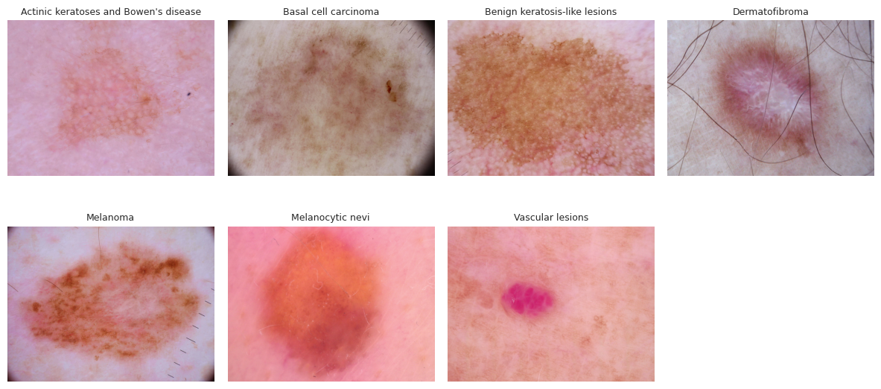
Introduction
Skin cancer ranks among the most prevalent and life-threatening malignancies worldwide, with incidence continuing to rise. Early detection through dermoscopic imaging can dramatically improve patient outcomes, yet manual interpretation remains time-consuming and variable across clinicians. Integrating advanced AI models into the diagnostic workflow holds the promise of consistent, high-accuracy screening. In this work, we present an efficient ensemble of EfficientNet-B3 and InceptionV3, tailored to the HAM10000 dataset, combining robust feature extraction and optimized training strategies to enhance multiclass lesion classification while maintaining inference speed and resource efficiency.
Fig: Sample Images of 7 Classes

Slide 4
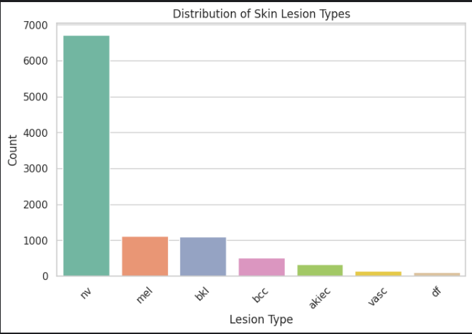
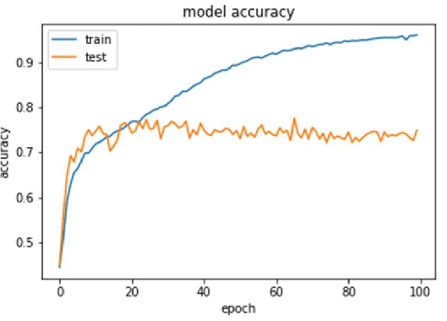
Problem Statement
Manual dermoscopic diagnosis is time-consuming, slowing clinical workflows.
Interpretation varies significantly between clinicians, leading to inconsistent results.
Extreme class imbalance in HAM10000 (e.g., rare lesion types) reduces model recall on minority classes.
Single CNN models often overfit abundant classes while under-detecting critical but scarce lesions.
Many existing ensembles improve accuracy but incur high inference latency and resource use.
Fig: Severe Class Imbalance
Fig: Overfitting in Single CNN Models

Slide 5
Motivation
Address High Mortality: Skin cancer remains one of the deadliest malignancies when diagnosed late. Leveraging deep learning can improve early detection, directly reducing mortality rates.
Reduce Diagnostic Variability: Manual dermoscopic interpretation suffers from inter-observer differences. An AI-driven ensemble ensures consistent lesion analysis across diverse clinical settings.
Mitigate Class Imbalance: Rare lesion types in HAM10000 hinder traditional CNN performance. Oversampling and mixed-precision training help the ensemble learn underrepresented classes more effectively.
Enhance Clinical Efficiency: Real-time inference with EfficientNet-B3 and InceptionV3 ensemble minimizes latency, allowing seamless integration into busy workflows without sacrificing accuracy.
Bridge Research Gaps: Few studies combine lesion-level splitting, advanced augmentation, and hybrid architectures for skin-lesion classification. This work fills that gap by unifying best practices in a single, optimized pipeline.

Slide 6
Objectives
Develop a hybrid ensemble model combining EfficientNet-B3 and InceptionV3 for robust multiclass classification on the HAM10000 dataset.
Implement lesion-level train/validation/test splitting to prevent data leakage and ensure genuine performance estimates.
Apply real-time data augmentation (flips, rotations, color jitter) and targeted oversampling to mitigate extreme class imbalance.
Leverage mixed-precision (FP16) training and gradient accumulation to enable larger effective batch sizes while optimizing memory and speed.
Design an ensemble strategy that balances accuracy and inference efficiency through weighted averaging of softmax outputs.
Integrate checkpointing based on validation metrics to retain and deploy the optimal model configuration.

Slide 7
Related Works
M. Shakya et al. Developed three deep learning–machine learning hybrids for melanoma on ISIC 2018, using active-contour segmentation plus scaling, denoising, and enhancement. Their top model fused ResNet-18 and MobileNet_V2 features with an SVM classifier, reaching 92.87% accuracy. Generalization may be limited by reliance on a single dataset.
P. Georgiadis et al. Created the Data Merger App to unify multiple skin-lesion datasets into large “hyperdatasets.” Evaluated VGG16, ResNet50, MobileNetV3-small, DenseNet-161, and ViT: achieved up to 91.87% accuracy on 9-way classification with ViT, but accuracy fell to 58% for 32 classes, underscoring scaling challenges.
M. Abdel et al. Introduced AEDHOA, a metaheuristic combining SRIS, ELCS, APS, and DES for robust feature selection. Tested on CEC benchmarks, UCI sets, and a skin-cancer dataset; achieved accuracies from 76% to 100%. Effectiveness on high-dimensional data is strong, though computational cost grows with dataset size.
Rodrigue et al. Compared YOLO v7 (transfer-learned) and a custom CNN on 2,792 augmented images for Basal Cell Carcinoma, Squamous Cell Carcinoma, and Melanoma. Their CNN attained 90.12% accuracy, 85.55% sensitivity, and 92.57% specificity, though limited sample size may constrain wider applicability.
A. A. Hussein et al. Proposed a hybrid quantum CNN + BiLSTM + MobileNetV2 model for skin cancer classification at 32×32 and 128×128 resolutions. Reported 89.3% accuracy, 89.81% F1, and 94.33% recall on malignant lesions. High performance is tempered by system complexity and quantum-component requirements.

Slide 8
Comparison Between Existing Works
Author and Year | Used Model | Achieved Accuracy | Key Contribution
M. Shakya et al.(2025) | ResNet-18 + MobileNet V2 features fed to SVM | 92.87% | Demonstrated that a hybrid deep-learning/ML pipeline outperforms single CNNs on ISIC-2018 while remaining lightweight.
P. Georgiadis et al.(2025) | Visual Transformer (ViT) on merged “hyper-datasets” | 91.87% (9 classes) / 58% (32 classes) | Introduced Data Merger App to automatically combine disparate skin-lesion datasets and showed benefits—and limits—of large, diverse training sets.
M. Abdel et al.(2025) | AEDHOA-selected feature subset with classical classifier | 0.76–1.00 (dataset-dependent) | Proposed Adaptive Enhanced Diversified Hiking Optimization Algorithm for robust feature selection on high-dimensional skin-cancer data.
Rodrigue et al.(2025) | Custom CNN (compared with YOLO v7 TL) | 90.12% | Built a compact CNN that slightly outperformed YOLO v7 for three common cancers using only 2,792 augmented images.
A. A. Hussein .(2025) | Hybrid Quantum CNN + BiLSTM + MobileNet V2 | 89.3% | Showed quantum-inspired feature extraction plus temporal context can boost lesion recognition, though with higher system complexity.
Our Proposed Model(2025) | EfficientNet-B3 + InceptionV3 weighted-softmax ensemble | 93% (HAM10000 validation) | Combines lesion-level split, targeted oversampling, mixed-precision training, and dual-backbone ensemble to improve minority-class recall without adding inference lag.

Slide 9
Gap Analysis
Lack of Multi-Dataset Generalization: Training is limited to HAM10000, missing variations in imaging, demographics, or lesions from real-world sources, reducing transferability to diverse environments like varying skin tones in Bangladesh. Future Solution: Integrate ISIC 2018/2019 or PAD-UFES-20 for cross-dataset training and fine-tuning, targeting 85%+ accuracy on unseen data via transfer learning.
Absence of Real-World Deployment Testing: Inference efficiency is optimized but unprofiled on clinic hardware, leaving latency claims theoretical and overlooking low-resource bottlenecks in rural settings. Future Solution: Benchmark on NVIDIA Jetson or mobile CPUs, apply quantization for sub-100ms times, and pilot a prototype app for clinician input.
Limited Explainability and Interpretability: The model lacks tools to explain predictions, essential for clinician trust in medical black-box systems. Future Solution: Add Grad-CAM or SHAP for heatmaps, integrate into evaluation, and validate with dermatologist reviews for clinical alignment.
Incomplete Handling of Edge Cases and Robustness: Augmentation addresses imbalance, but no stress-testing against noise, artifacts, or adversarial examples; per-class metrics are unreported from runs. Future Solution: Inject synthetic noise and adversarial training; conduct ablation studies to boost minority F1 above 90% via hyperparameter tuning.
Scalability to More Classes or Modalities: Tailored to 7 classes, it doesn't scale to finer sub-types or multi-modal data like patient metadata (age, UV exposure).

Slide 10
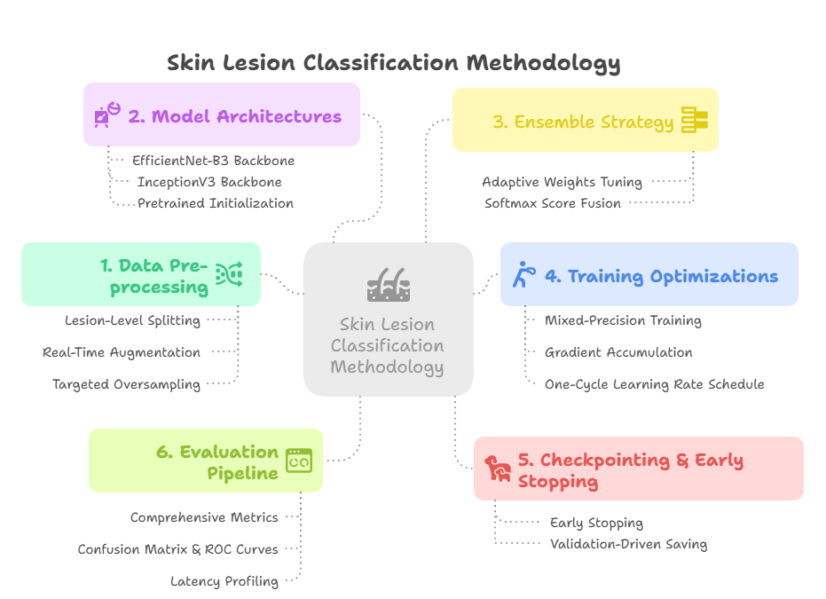
Proposed Methodology

Slide 11
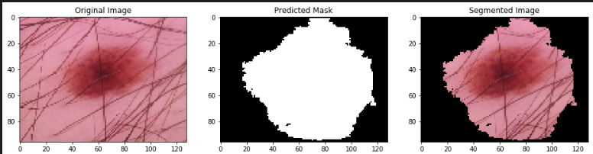
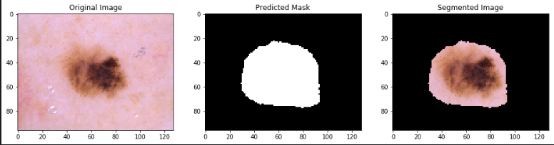
Proposed Methodology
Data Preprocessing
Lesion-Level Splitting: Partition the HAM10000 dataset by unique lesion identifiers to ensure no images of the same lesion appear across train, validation, and test sets, eliminating data leakage.
Real-Time Augmentation: Apply on-the-fly transformations (random flips, rotations up to ±30°, color jitter, and random crops) during training to increase data diversity without inflating storage.
Targeted Oversampling: Dynamically replicate underrepresented classes in each epoch to balance batch composition and improve minority-class learning.
Model Architectures
EfficientNet-B3 Backbone: Leverage EfficientNet’s compound scaling to extract robust features with relatively low parameter count and FLOPs.
InceptionV3 Backbone: Capture multi-scale spatial patterns via its parallel convolutional branches, complementing EfficientNet features.
Pretrained Initialization: Initialize both networks with ImageNet weights to accelerate convergence and leverage transferable representations.
Ensemble Strategy
Softmax Score Fusion: For each input, compute class probabilities from both backbones, then combine via weighted averaging (e.g., 0.6·EfficientNet + 0.4·Inception) to balance their strengths.
Adaptive Weights Tuning: Optimize fusion weights on the validation set using grid search to maximize macro-F1 score, emphasizing minority classes.

Slide 12
Proposed Methodology
Training Optimizations
Mixed-Precision Training: Use FP16 arithmetic with dynamic loss scaling to accelerate training and reduce GPU memory usage without sacrificing numerical stability.
Gradient Accumulation: Accumulate gradients over multiple mini-batches to simulate larger batch sizes, stabilizing updates when hardware memory is limited.
One-Cycle Learning Rate Schedule: Employ a triangular learning-rate policy that ramps up then down over each epoch to foster faster convergence and avoid local minima.
Checkpointing & Early Stopping
Validation-Driven Saving: After each epoch, save model weights when macro-F1 on the validation set improves, ensuring the best ensemble components are retained.
Early Stopping: Halt training if no validation F1 improvement occurs for 10 consecutive epochs to prevent overfitting and conserve resources.
Evaluation Pipeline
Comprehensive Metrics: Report overall accuracy, per-class precision, recall, and F1—highlighting performance on rare lesion categories.
Confusion Matrix & ROC Curves: Generate normalized confusion matrices and per-class ROC curves to visualize error patterns and diagnostic thresholds.
Latency Profiling: Measure end-to-end inference time on target hardware to confirm that the ensemble meets clinical throughput requirements.

Slide 13

Any Question

Slide 14
THANK YOU

